Slide 1
ERPL DSL for escape rooms
Tiago Luís Dias da Silva
Departamento de Informática, Universidade do Minho, Braga, Portugal,
José João Almeida
Algoritmi, LASI, Departamento de Informática, Universidade do Minho, Braga, Portugal

Slide 2
Motivation
Why Escape Rooms?
Present in education, tourism and leisure
Promote cognitive skills
Promote teamwork
Problem solving in a stimulating environment
Great demand for unique experiences
Lots of diversity in themes, formats and mechanics.
Why a DSL?
Specifity in a domain
Ease of understanding
Versatile and easy to reuse (e.g. templates and scripting)
Fast development

Slide 3
Goals
Facilitating the creation of escape rooms
Promoting reusability and modularity
Ensuring scalability and extensibility

Slide 4








Technologies
Tools that can be used to create Escape Rooms
Interactive Presentation Tools. Genially, PowerPoint, Prezzi, etc.
Scratch. Visual programming platform designed to facilitate the creation of interactive projects, games and animations.
CospacesEdu. Tool for creating three-dimensional environments.
Room Escape Maker. Free online escape room editor game.
Escapp. Tool for configuring escape rooms aimed at education.
Engines for creating 2D games. GameSalad, BuildBox, Godot, etc.
Tools used in this project
Lark. Python parsing library
Pygame. Python game library.
P5. JavaScript library aimed at creating graphics and interactivity in web contexts.
Blockly. Client-side library for the JavaScript programming language to create block-based visual programming languages ​​and editors.

Slide 5
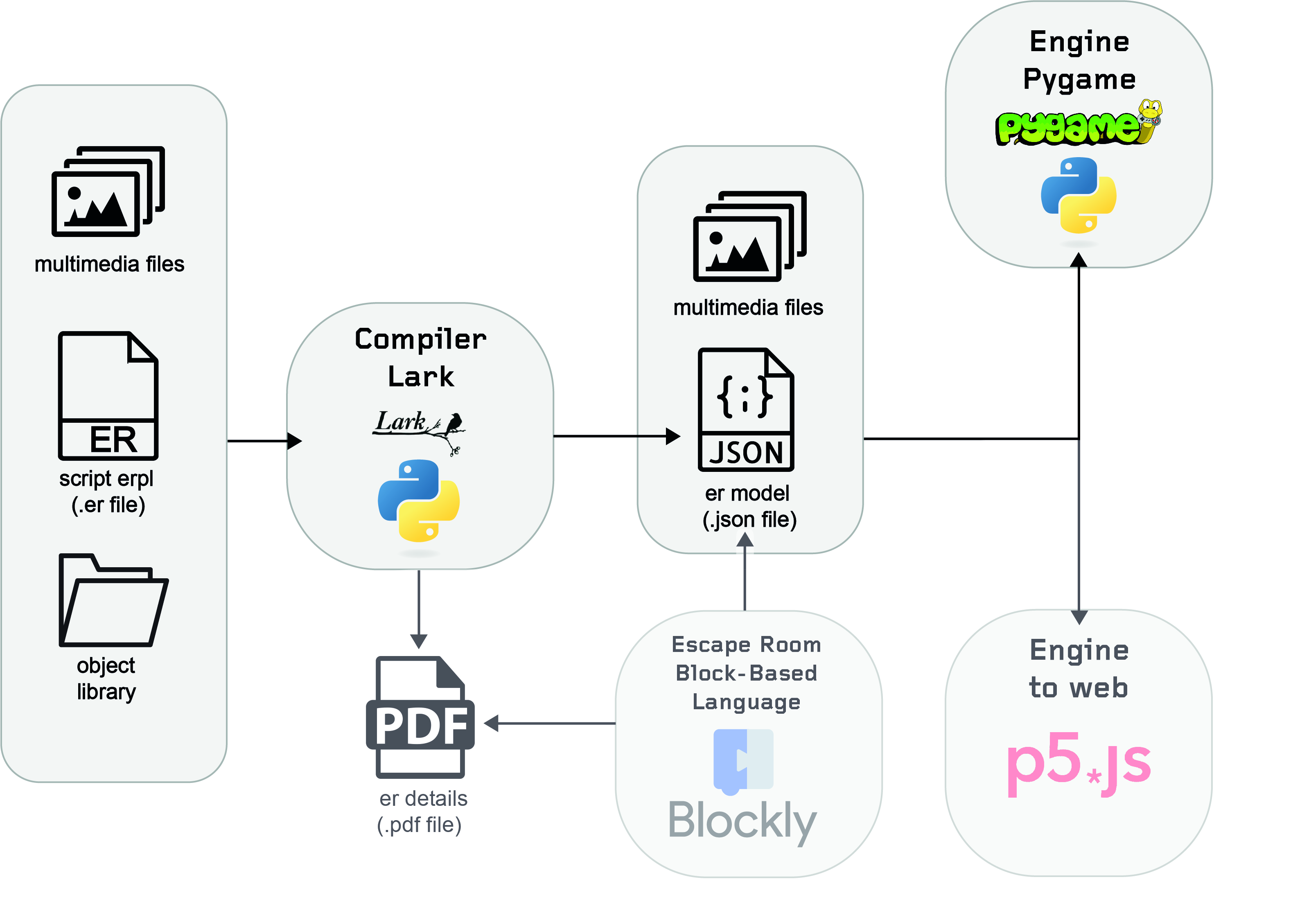
Architecture

Slide 6
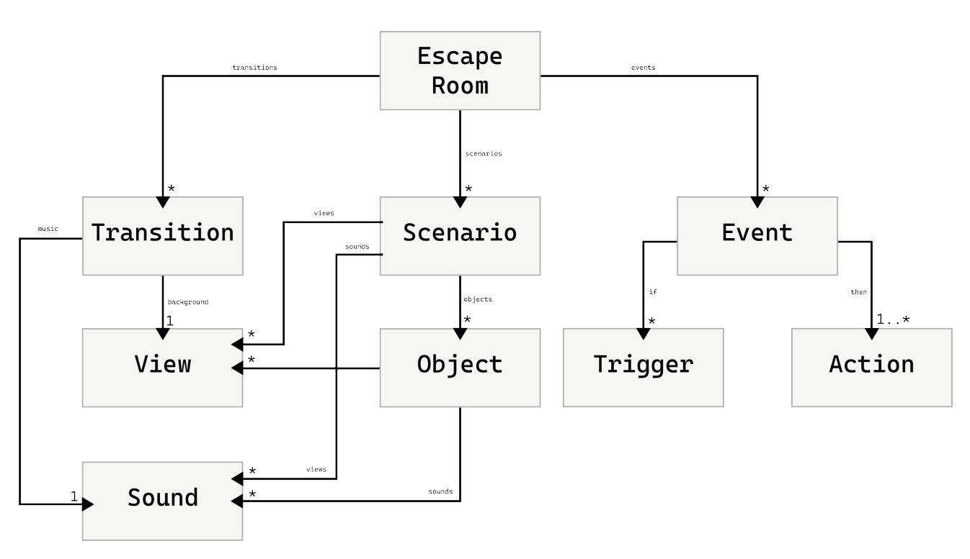
Model

Slide 7
Escape Rooms Typologies
Themes (Mediaval, Futuristic, Educational, Terror, Aventura, etc…):
Allow imports of new assets (images, audio, etc)
Starter kits specialized in diffrent themes
Templates
Format:
Discard in-person escape rooms, due to their nature.
It will not support 3D and VR virtual escape rooms, due to the complexity in devolpment.
It will focus on covering 2D virtual escape rooms.
Mechanics:
Point-and-Click
Drag-and-Drop
Interactions with text
Logic Flow
Multiple Paths
Online Cooperative Elements

Slide 8
Events - Triggers
Triggers
• click Object_id
• click not Object_id
• Object_id is View_id
• Event_id already happened
• Object_id is in use
• Number seconds have already passed

Slide 9
Events - Actions
Actions:
• Object_id change to View_id
• Object_id goes to inventory
• end of game
• show message Text in Position
• Object_id change size to Size
• Object_id move to Position
• change to Scenario_id
• Object_id is removed
• play Sound_id of Object_id|Scenario_id
• start challenge Challenge_id
• transition Transition_id

Slide 10
Events - Challenges
Challenges:
• Question
• Motion (one object to another)
• Multiple Choice
• Connection
• Sequence
• Puzzle
• Slide Puzzle

Slide 11
Escape Room
EscapeRoom(
title="Mission Solar System",
size=[1280,720],
scenarios=[station],
events=[try_open,event_open,show_error,exit],
transitions=[intro],
start=intro
)

Slide 12
View/Sound
sound_opening = Sound(source="door-opening.mp3")
door_closed = View.Static(image="door_closed.png")
door_opened = View.Animated(
images=["door_semi_closed.png","door_open.png"],
repetitions=1,
time_sprite=3
)

Slide 13
Object
door = Object(
initial_view = door_closed,
views = [door_closed,door_opened],
position = (497,310),
size=[286,300],
sounds = [sound_opening]
)

Slide 14
Scenario
station = Scenario(
initial_view = View.Static.background(image="room.png"),
views = [background],
objects = [door],
sounds = []
)

Slide 15
Transition (Telling the story)
Transition(
background = View.Static.station(image="station.png"),
music = Sound.music(source="intro.mp3"),
story = "You and your team are astronauts on a special mission to explore the solar system.\n However, during the journey, you get trapped in a space station and need to solve a \nseries of puzzles to escape before time runs out and the spaceship leaves without you.”
)

Slide 16
Events
Trigger
Action
exit = Event(if = click door and door is door_opened, then = end of game)

Slide 17
Events
Action
(Sucess)
Trigger
Challenge
Action
(Fail)

Slide 18
Events
event_open = Event(then = door change to door_opened and play sound_opening of door)
show_error = Event(then = show message "Wrong!" in (497,310))
question_planets = Challenge.Sequence(
question= "Choose from the planet clos...",
sequence= ["Mercury","Earth","Jupiter","Neptune"],
sucess= event_open,
fail=show_error
)
try_open = Event(if = click door and door is door_closed, then = start challenge question_planets)

Slide 19
Example – Space Station

Slide 20
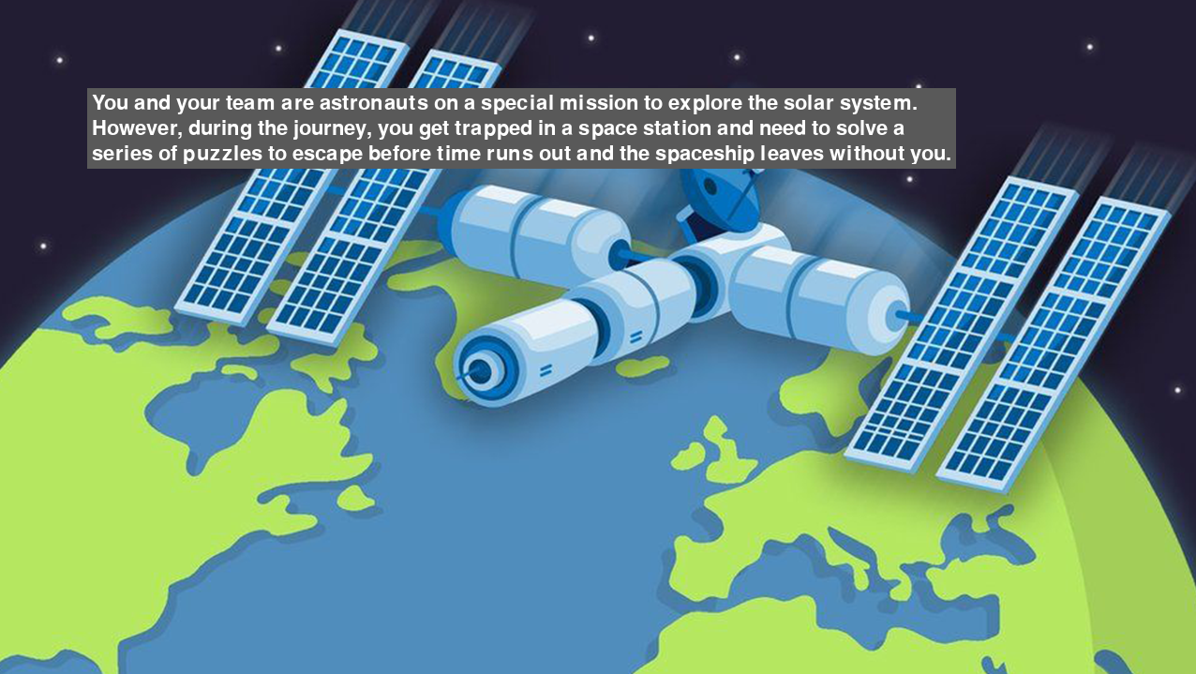

Slide 21
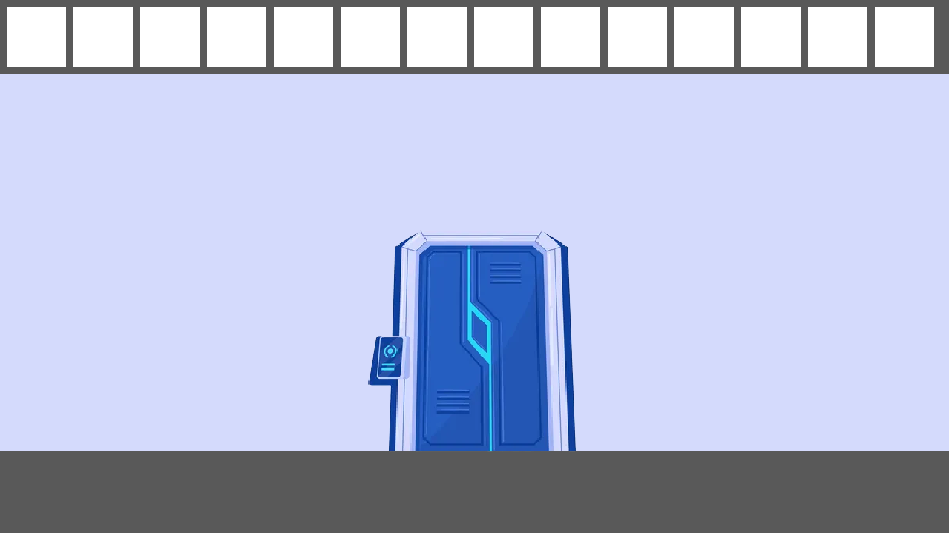

Slide 22
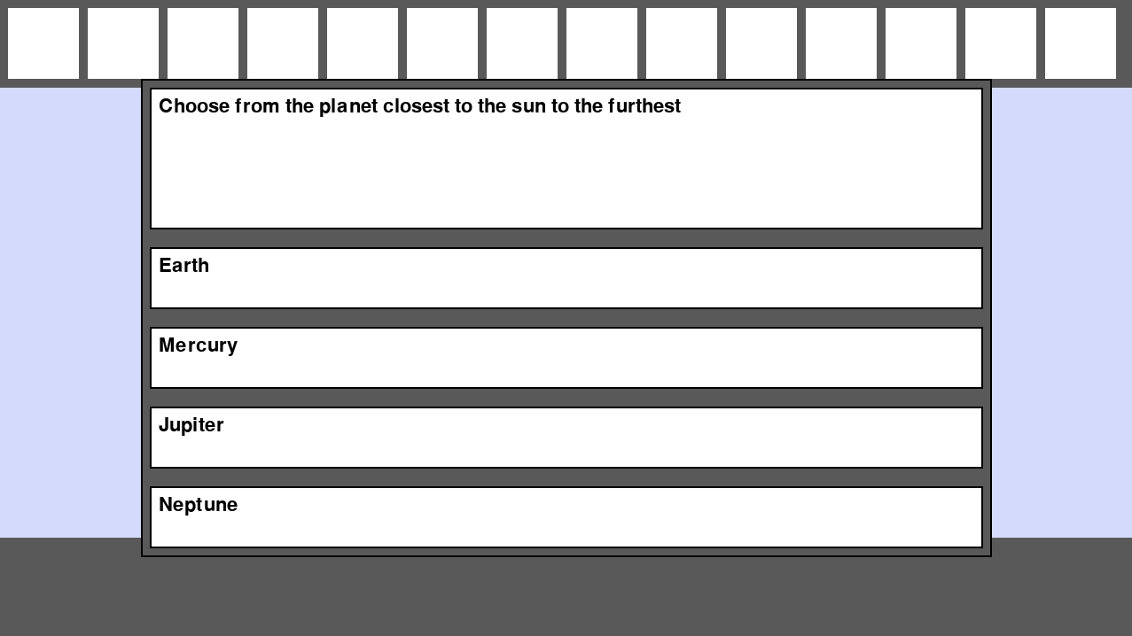

Slide 23
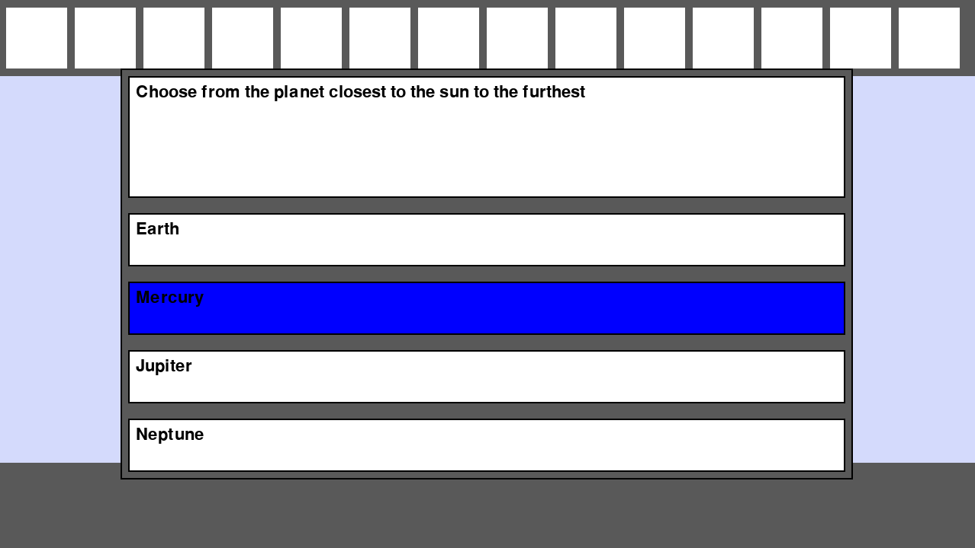

Slide 24
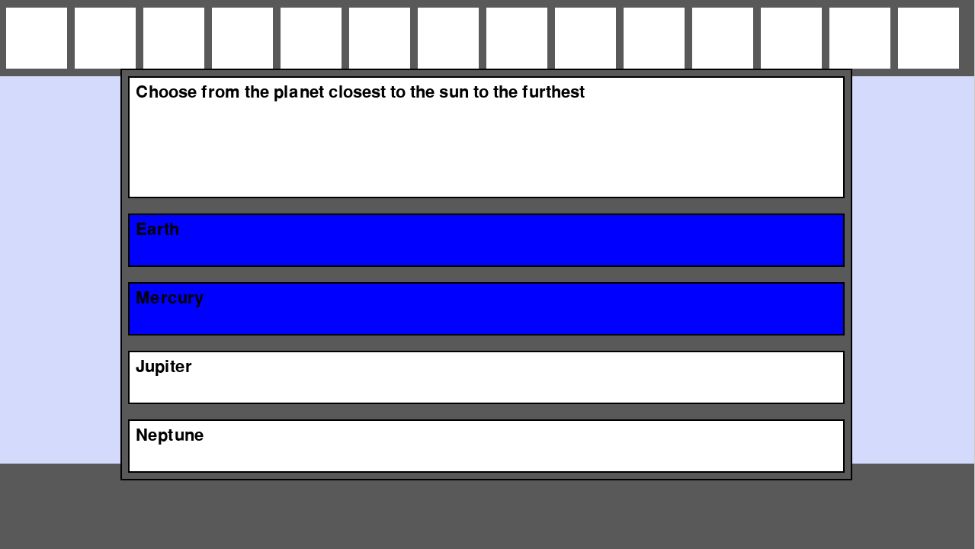

Slide 25
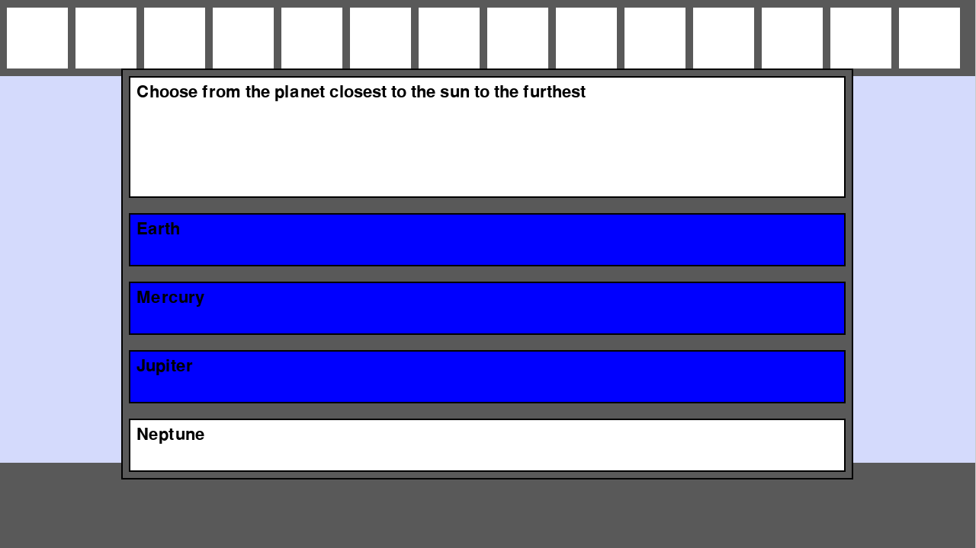

Slide 26
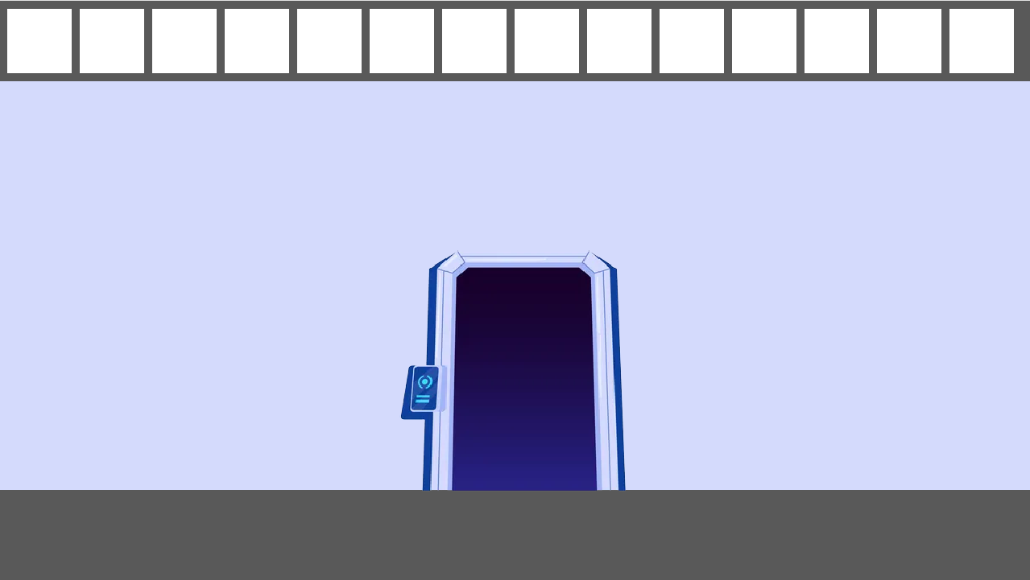

Slide 27


Slide 28
Example – Locked Room

Slide 29
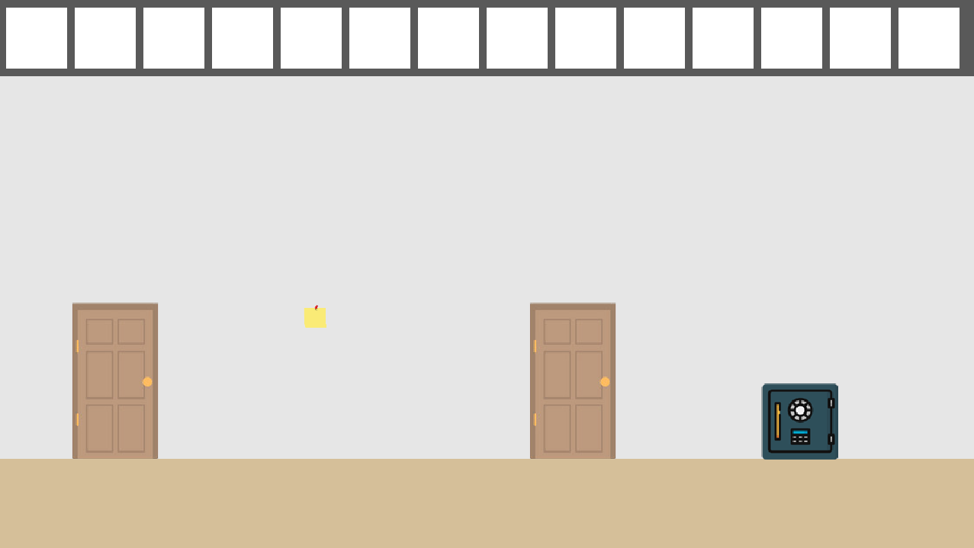

Slide 30
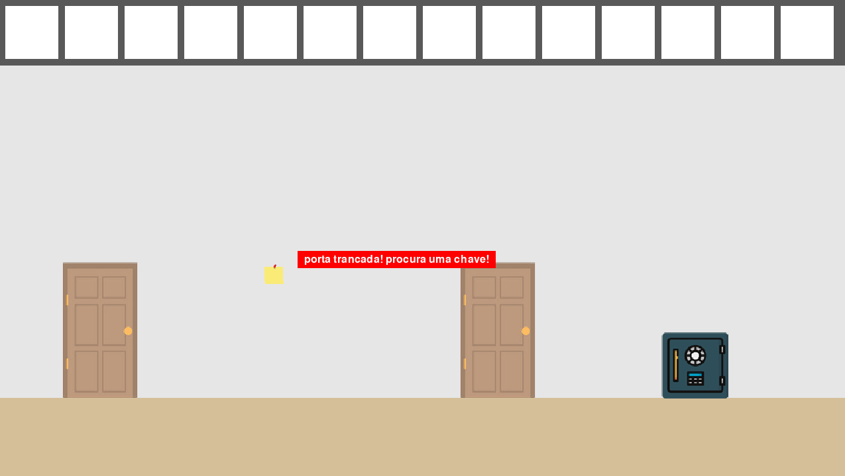

Slide 31
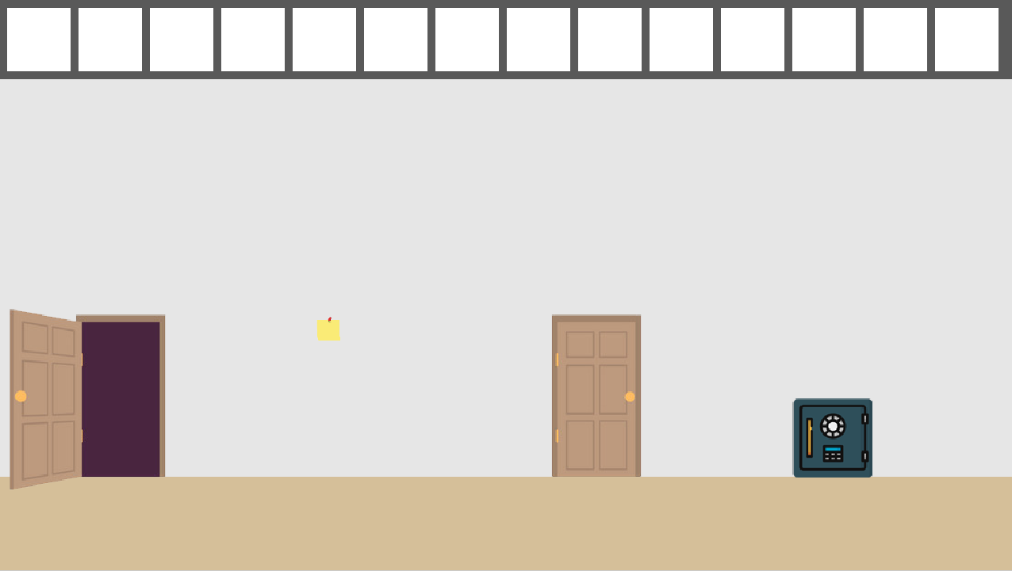

Slide 32
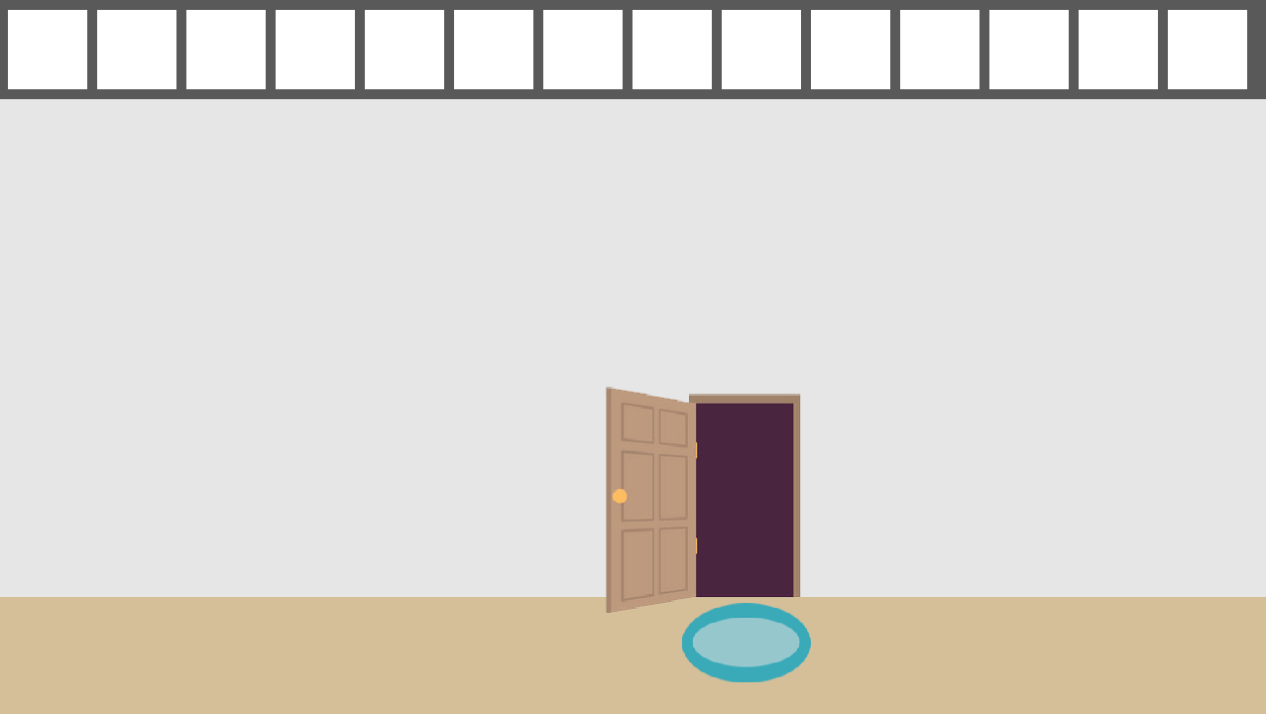

Slide 33
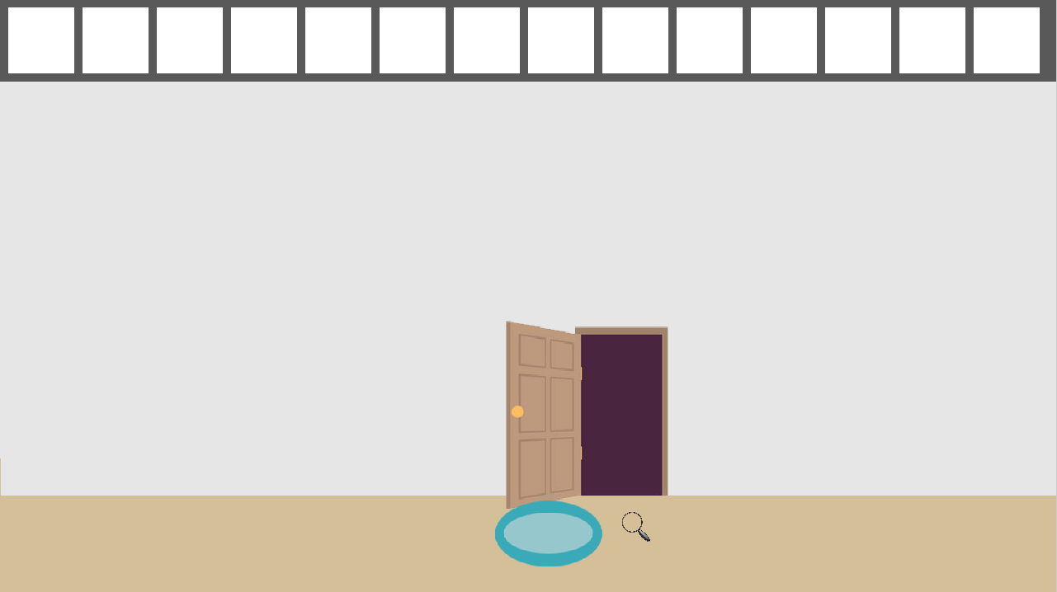

Slide 34
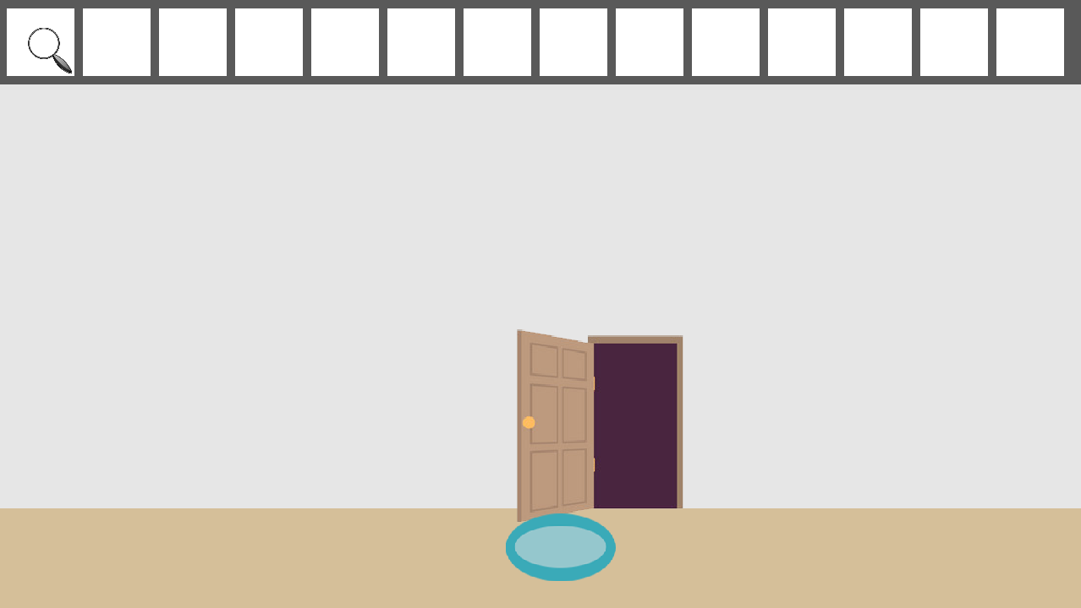

Slide 35
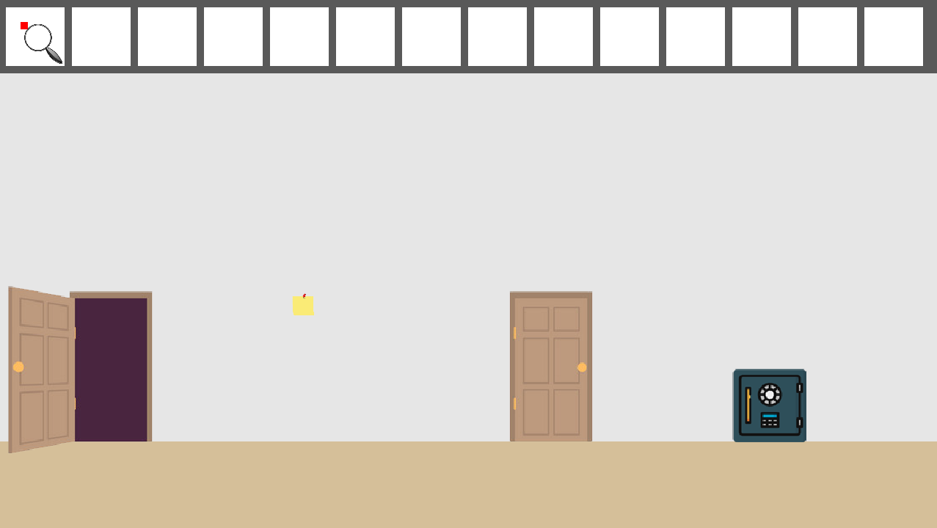

Slide 36
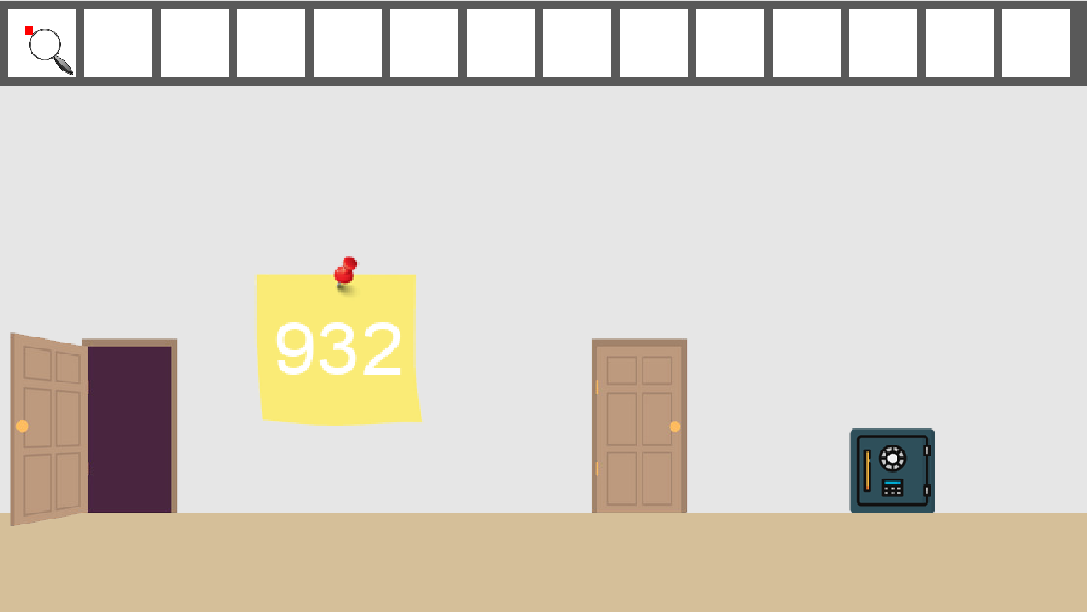

Slide 37
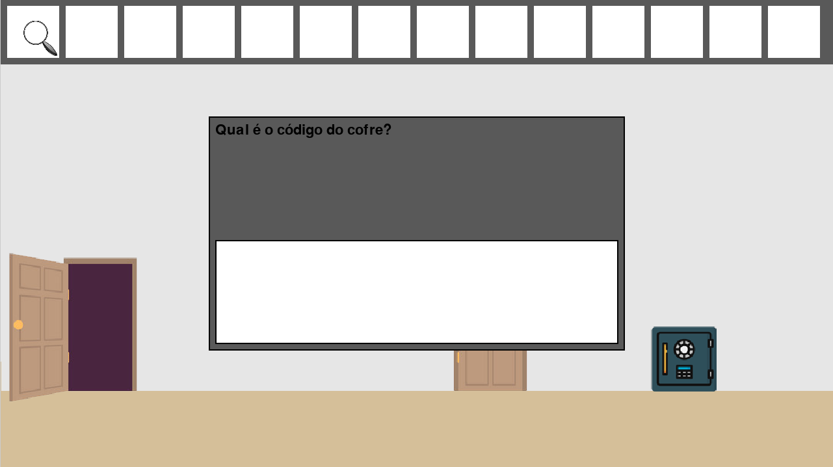

Slide 38


Slide 39
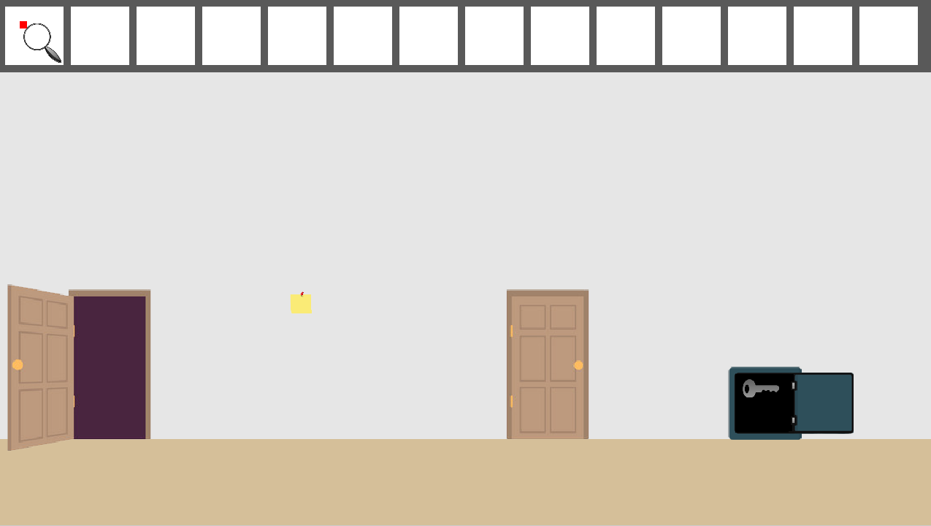

Slide 40
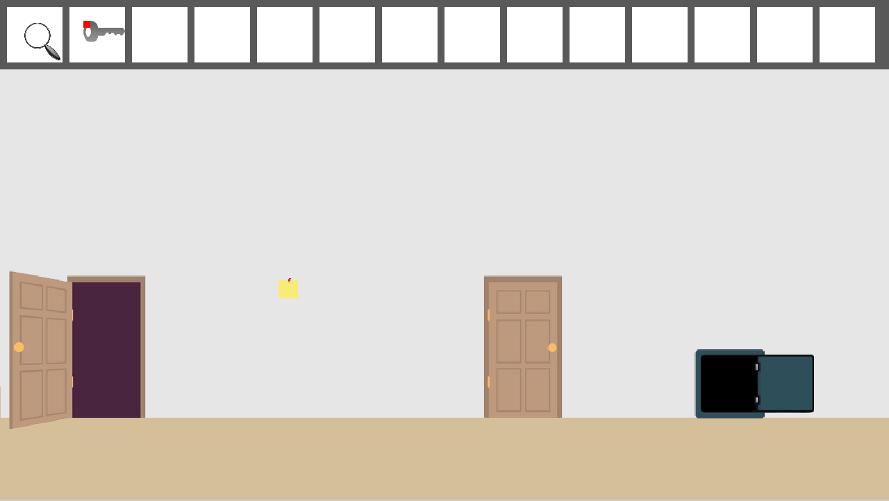

Slide 41
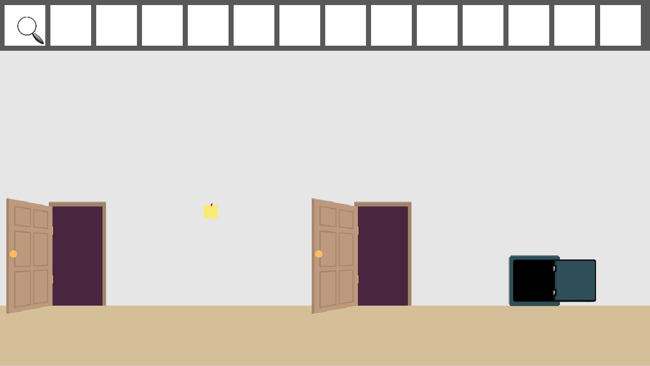

Slide 43
Imports
import Object.door
door1 = Object.door
door2 = Object.door(position = (100,100))
#It is possible to change some parameters of an imported object.

Slide 44
Python Block
door_animated_example1 = Python.door
door_animated_example2 = Python.get_images("door")
door_opened = View.Animated(
images=door_animated_example1,repetitions=1,time_sprite=3
)
__Python__ #This is python code
import glob
door = glob.glob("../assets/images/door/*.png")
def get_images(object):
return glob.glob(f"../assets/images/{object}/*.png")

Slide 45
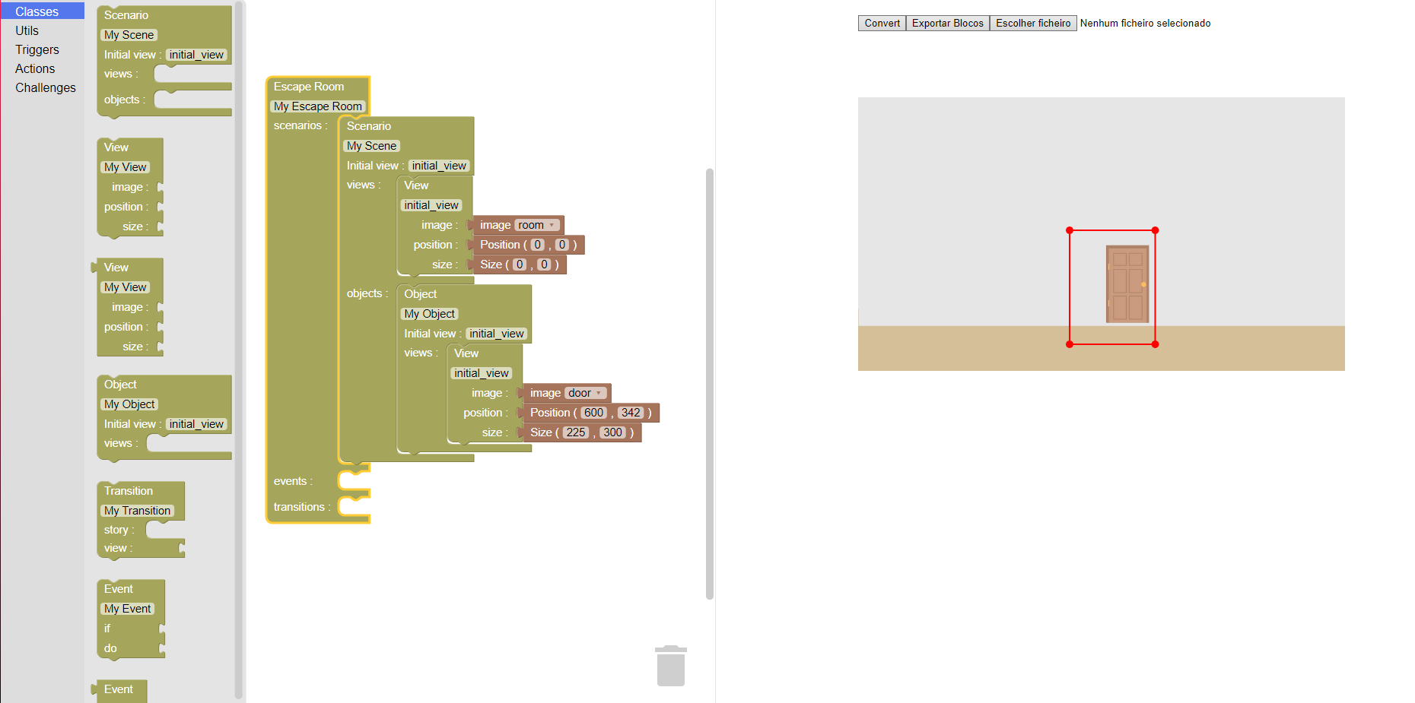
Escape Room Block-Based Language (Web ERPL) [Demo]

Slide 46
Project Links
Project Github: github.com/surumkata/ERPL
Pypi Project Page: pypi.org/project/erpl/
Web ERPL Demo: surumkata.github.io/weberpl/

Slide 47
Conclusion
Future Work:
Enhance the engine to improve performance and add new features.
Introduce a variety of challenges to enrich player experiences.
Develop a web engine and block-based language to expand the reach of virtual escape rooms.
Create usable templates and scripts to streamline development processes.
Implement a graphical interface that integrates with the language to simplify escape room creation.

Slide 48
Questions and Sugestions

